Slide 1

Closing the Project

Slide 2
Chapter Concepts
Actions that should be taken when closing a project
Conducting a post project evaluation
The importance of documenting lessons learnt
The need to organise and archive project documents
Obtaining feedback from the customer about the project
Early termination of projects

Slide 3
Learning Outcomes
Identify actions that should be taken during the process of closing a project
Conduct a post project evaluation
Discuss the value and use of lessons learnt
Explain the importance of organising and archiving project documents
Obtain customer feedback about the project
Describe situations that could result in early project termination

Slide 4
Project Integration Management
Project Management Knowledge Areas from PMBOK® Guide

Slide 5
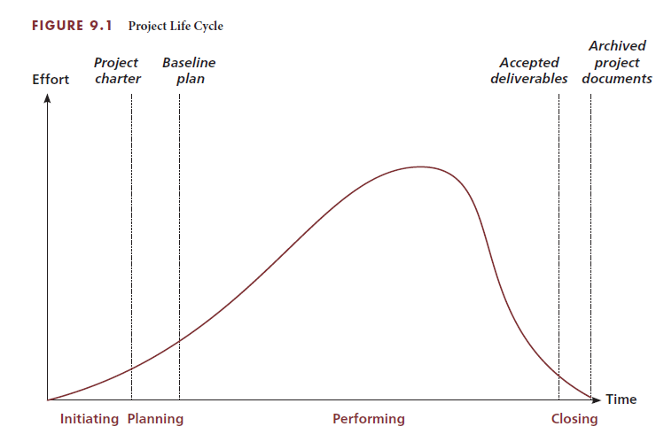
Project Closing Actions
Collect and make final payments
Recognise and evaluate staff
Conduct post project evaluation
Document lessons learnt
Organise and archive project documents

Slide 6
Final payments
Payments from customer
Have activity listed to perform collection
Assure that all the payments have been received
Payments to others
Verify all payments have been made
Record actual costs
Account closing
Perform financial analysis on the project
Compare actual costs versus baseline budget

Slide 7
Staff recognition and evaluation
End project with recognition and celebration
Recognise team members for contributions
Celebrate the success of the project
Prepare individual performance evaluations
Mention how knowledge expanded during project
Identify areas where need further development
Share during individual meetings or give to supervisor

Slide 8
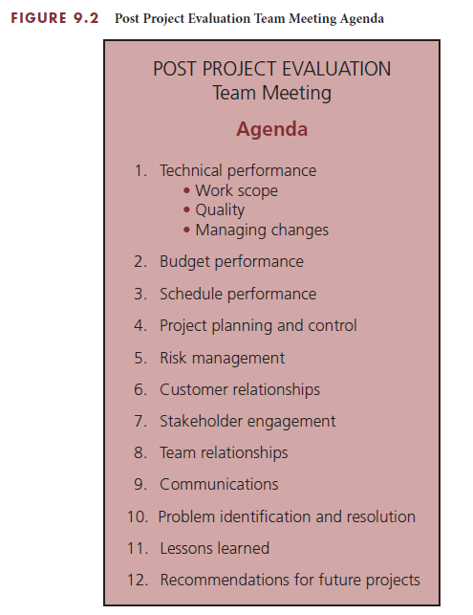
Post project evaluation
Review and evaluate project performance
Identify improvements
Hold individual meetings with members
Hold project team meeting
Prepare written report with lessons learnt and recommendations

Slide 9
Lessons learnt
Purpose of identifying and documenting
Capitalise on knowledge and experience gained
Improve performance on future projects
Knowledge base system or repository
Retrieve lessons learnt from prior projects
Easily access information by category or subject
Record keeping throughout project
Capture lesson at time of lesson instead of end of project
Have as agenda topic at meetings and in training sessions

Slide 10
Archive project documents
Organise, file, and archive appropriate documents
Organise system to make information easily retrievable
Create database of common data elements
Analyse elements for trends
Examine records for bidding, planning, and performing future projects

Slide 11
Customer Feedback
Post project evaluation meeting with customer
Determine if provided the expected benefits
Assess the level of customer satisfaction
Obtain any feedback with open-ended questions
Discuss future opportunities
Secure permission to use as reference
Participants
Key project team members
Key customer representatives
Project manager

Slide 12
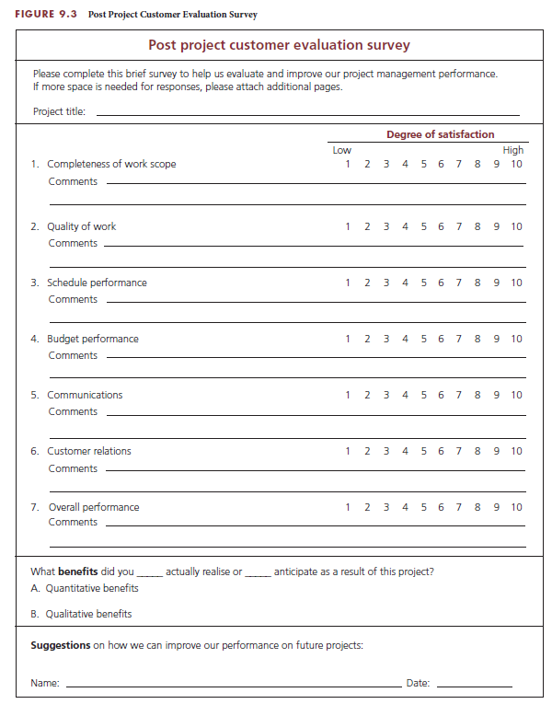
Post-project customer evaluation survey
Analyse for trends
Seek permission for reference

Slide 13
Critical Success Factors
Recognise the project team and celebrate achievements throughout the project.
Regularly ask the customer about the level of satisfaction with the performance and progress of the project and take corrective action at the first hint that the customer is not satisfied.
After the conclusion of a project, the project performance should be evaluated to learn what could be improved if a similar project were to be done in the future. Feedback should be obtained from the customer and the project team.
Capture and document lessons learnt throughout the performance of the project.
Establish a knowledge base of lessons learnt and ensure that they are communicated and used on future projects.
Organise and archive project documentation and analyse key data that could be helpful in bidding, planning, or performing future projects.
Retain customer evaluation and feedback information that could be valuable in developing proposals for other projects for the same customer in the future.

Slide 14
Summary
The fourth and final phase of the project life cycle is closing the project.
An important project closing action is staff recognition and evaluation.
Conduct post project evaluation meetings within the project team or organisation with individual team members and a group meeting with the project team to gather team feedback for improved future performance.
Identify and document lessons learnt to capitalise on the knowledge and experience gained on the project in order to improve performance on future projects.
The project team or contractor should ensure that copies of appropriate project documentation are properly organised, filed, and archived so that they can be readily retrieved for future use.
Conduct a post project evaluation meeting, or distribute a customer evaluation survey to the customer or sponsor to determine whether the project provided the customer with expected benefits; assess the level of customer satisfaction; and obtain any feedback that would be helpful in future business relationships with this customer or with other customers.
Projects may be terminated before completion for various reasons.

